Slide 1
Sign Language Detection Using Convolutional Neural Networks (CNN)
Anurag Balasaheb Dome
Department of Software Engineering
Univ. of Europe for Applied Sciences
Konrad-Ruse Ring 11, 14469 Potsdam, Germany
anurag.dome@ue.germany.de
Prof. Raja Hashim Ali
Department of Business AI Research Group
Univ. of Europe for Applied Sciences
Konrad-Ruse Ring 11, 14469 Potsdam, Germany hashim.ali@ue-germany.de

Slide 2
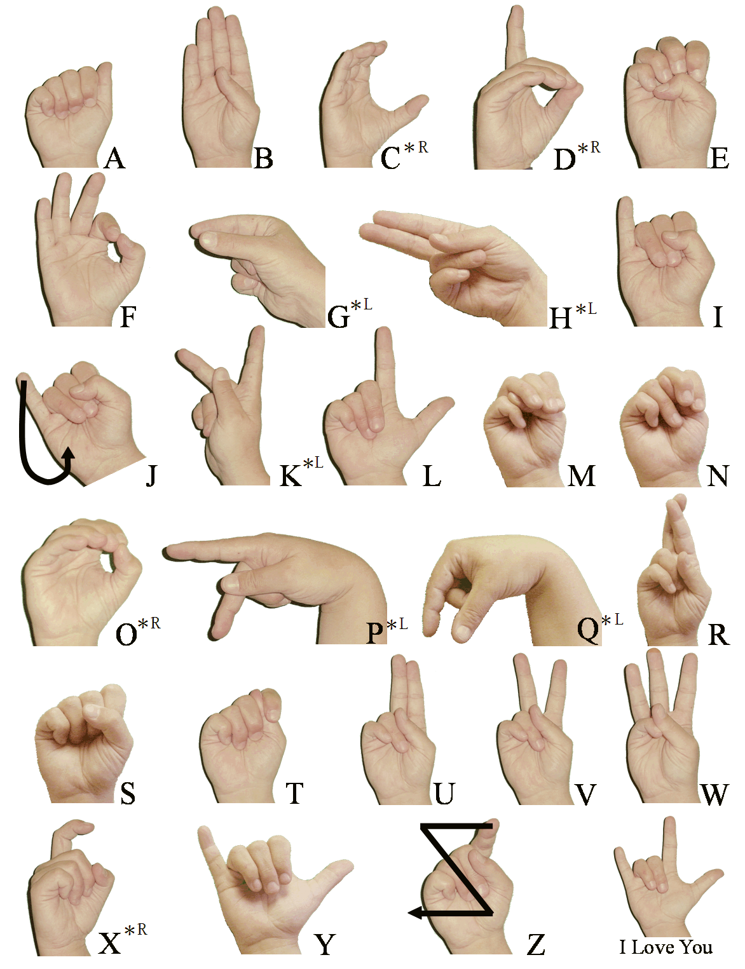
Introduction
Sign language is vital for deaf communication.
Traditional translation methods are limited and costly.
Objective: Build a CNN to recognize ASL signs from images.
Promotes accessible, real-time communication via AI.

Slide 3
Problem Statement
Model Compactness: Achieve high accuracy with <1M parameters.
Augmentation Efficacy: Enhance model robustness using augmentation.
Edge Deployment: Ensure real-time use on devices like Raspberry Pi.

Slide 4


Methodology – Dataset
Dataset: Sign Language MNIST – 27,455 grayscale images.
Classes: 24 ASL letters (excluding J).
Images upscaled to 64×64 via bilinear interpolation.
Balanced: 24,500 training / 2,950 test samples.

Slide 5
Methodology – Data Preprocessing
Normalized pixel values to [0, 1].
Stratified train-validation split.
Augmentations:
Rotation (±15°), Translation (10%), Zoom (±10%), Flip, Brightness.

Slide 6
Methodology – Model Architecture
Input: 64×64×1 grayscale image.
Three Conv layers (32, 64, 128 filters) with ReLU, BN, MaxPooling.
Dense: 128 neurons + Dropout(0.5).
Output: 24 neurons (SoftMax).
Total Params: ~850K.

Slide 7
Methodology – Training Configuration
Optimizer: Adam (lr=0.001).
Loss: Categorical Cross-Entropy.
Batch Size: 32, Epochs: 20 (EarlyStopping = 5).
Hardware: NVIDIA GPU.

Slide 8
Results
Validation Accuracy: ~99% by epoch 8.
Classification Report: Precision/Recall/F1 ≈ 0.99.
Confusion Matrix shows minor confusion (e.g., G vs. H).
Model size <5MB – ideal for mobile/edge deployment.

Slide 9
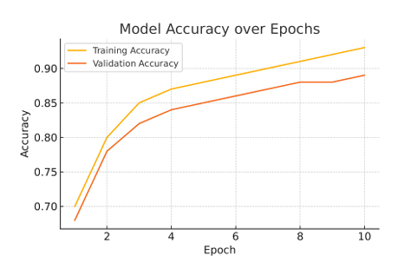
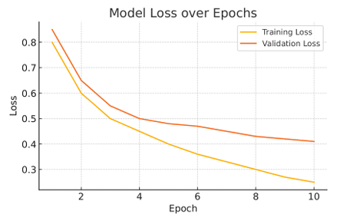
Training Curves

Slide 10
Observations
Data augmentation improved generalization.
Overfitting avoided – aligned training/validation loss.
Static dataset limits recognition of dynamic gestures.
Misclassifications in similar hand shapes (G, H).

Slide 11
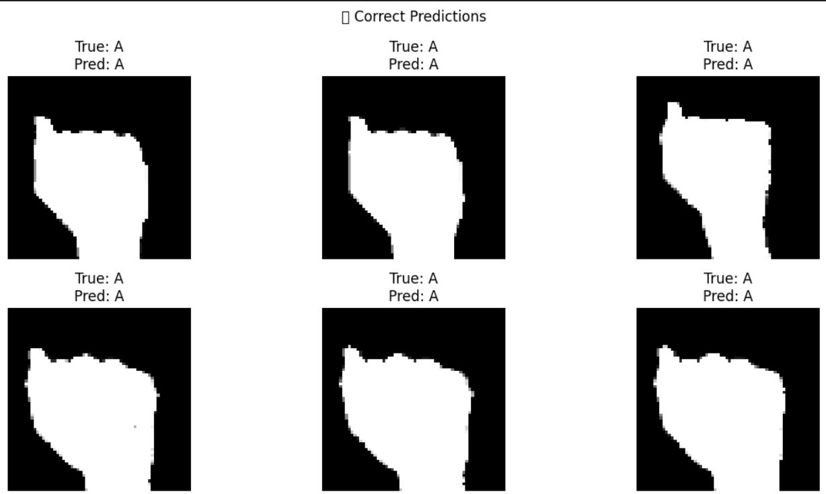
Correct Predictions

Slide 12
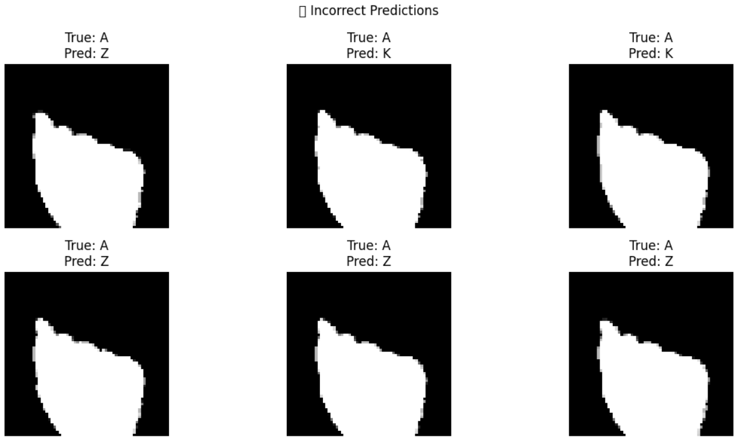
Incorrect Predictions

Slide 13
Conclusion
Achieved high accuracy with compact CNN architecture.
Model is efficient for edge deployment (e.g., smartphones).
Future Work:
Support dynamic gestures (CNN + LSTM).
Real-world RGB datasets.
Personalized model refinement.
Deployment via TensorFlow Lite or ONNX.

Slide 14
Rubrics for evaluation

Slide 15
Thank You !

